Slide 2
Architecture
Best IT ops experience
Best developer experience
CaaS↔PaaS | Faas
OpenShift provides:
Integrated platform including container engine, Monitoring, Service Mesh and CICD pipelines.
Core OS
Kubernetes Integrated
Automated installation
Automated image builds
Autoscaling
Certified application services
Cluster services monitoring, showback, registry, logging
Application services
middleware, functions, ISV
Developer services
dev tools, automated builds, CI/CD, IDE
Service mesh
Automated operations
certified
Enterprise Linux CoreOS
Physical
Virtual
Private
Public

Slide 3








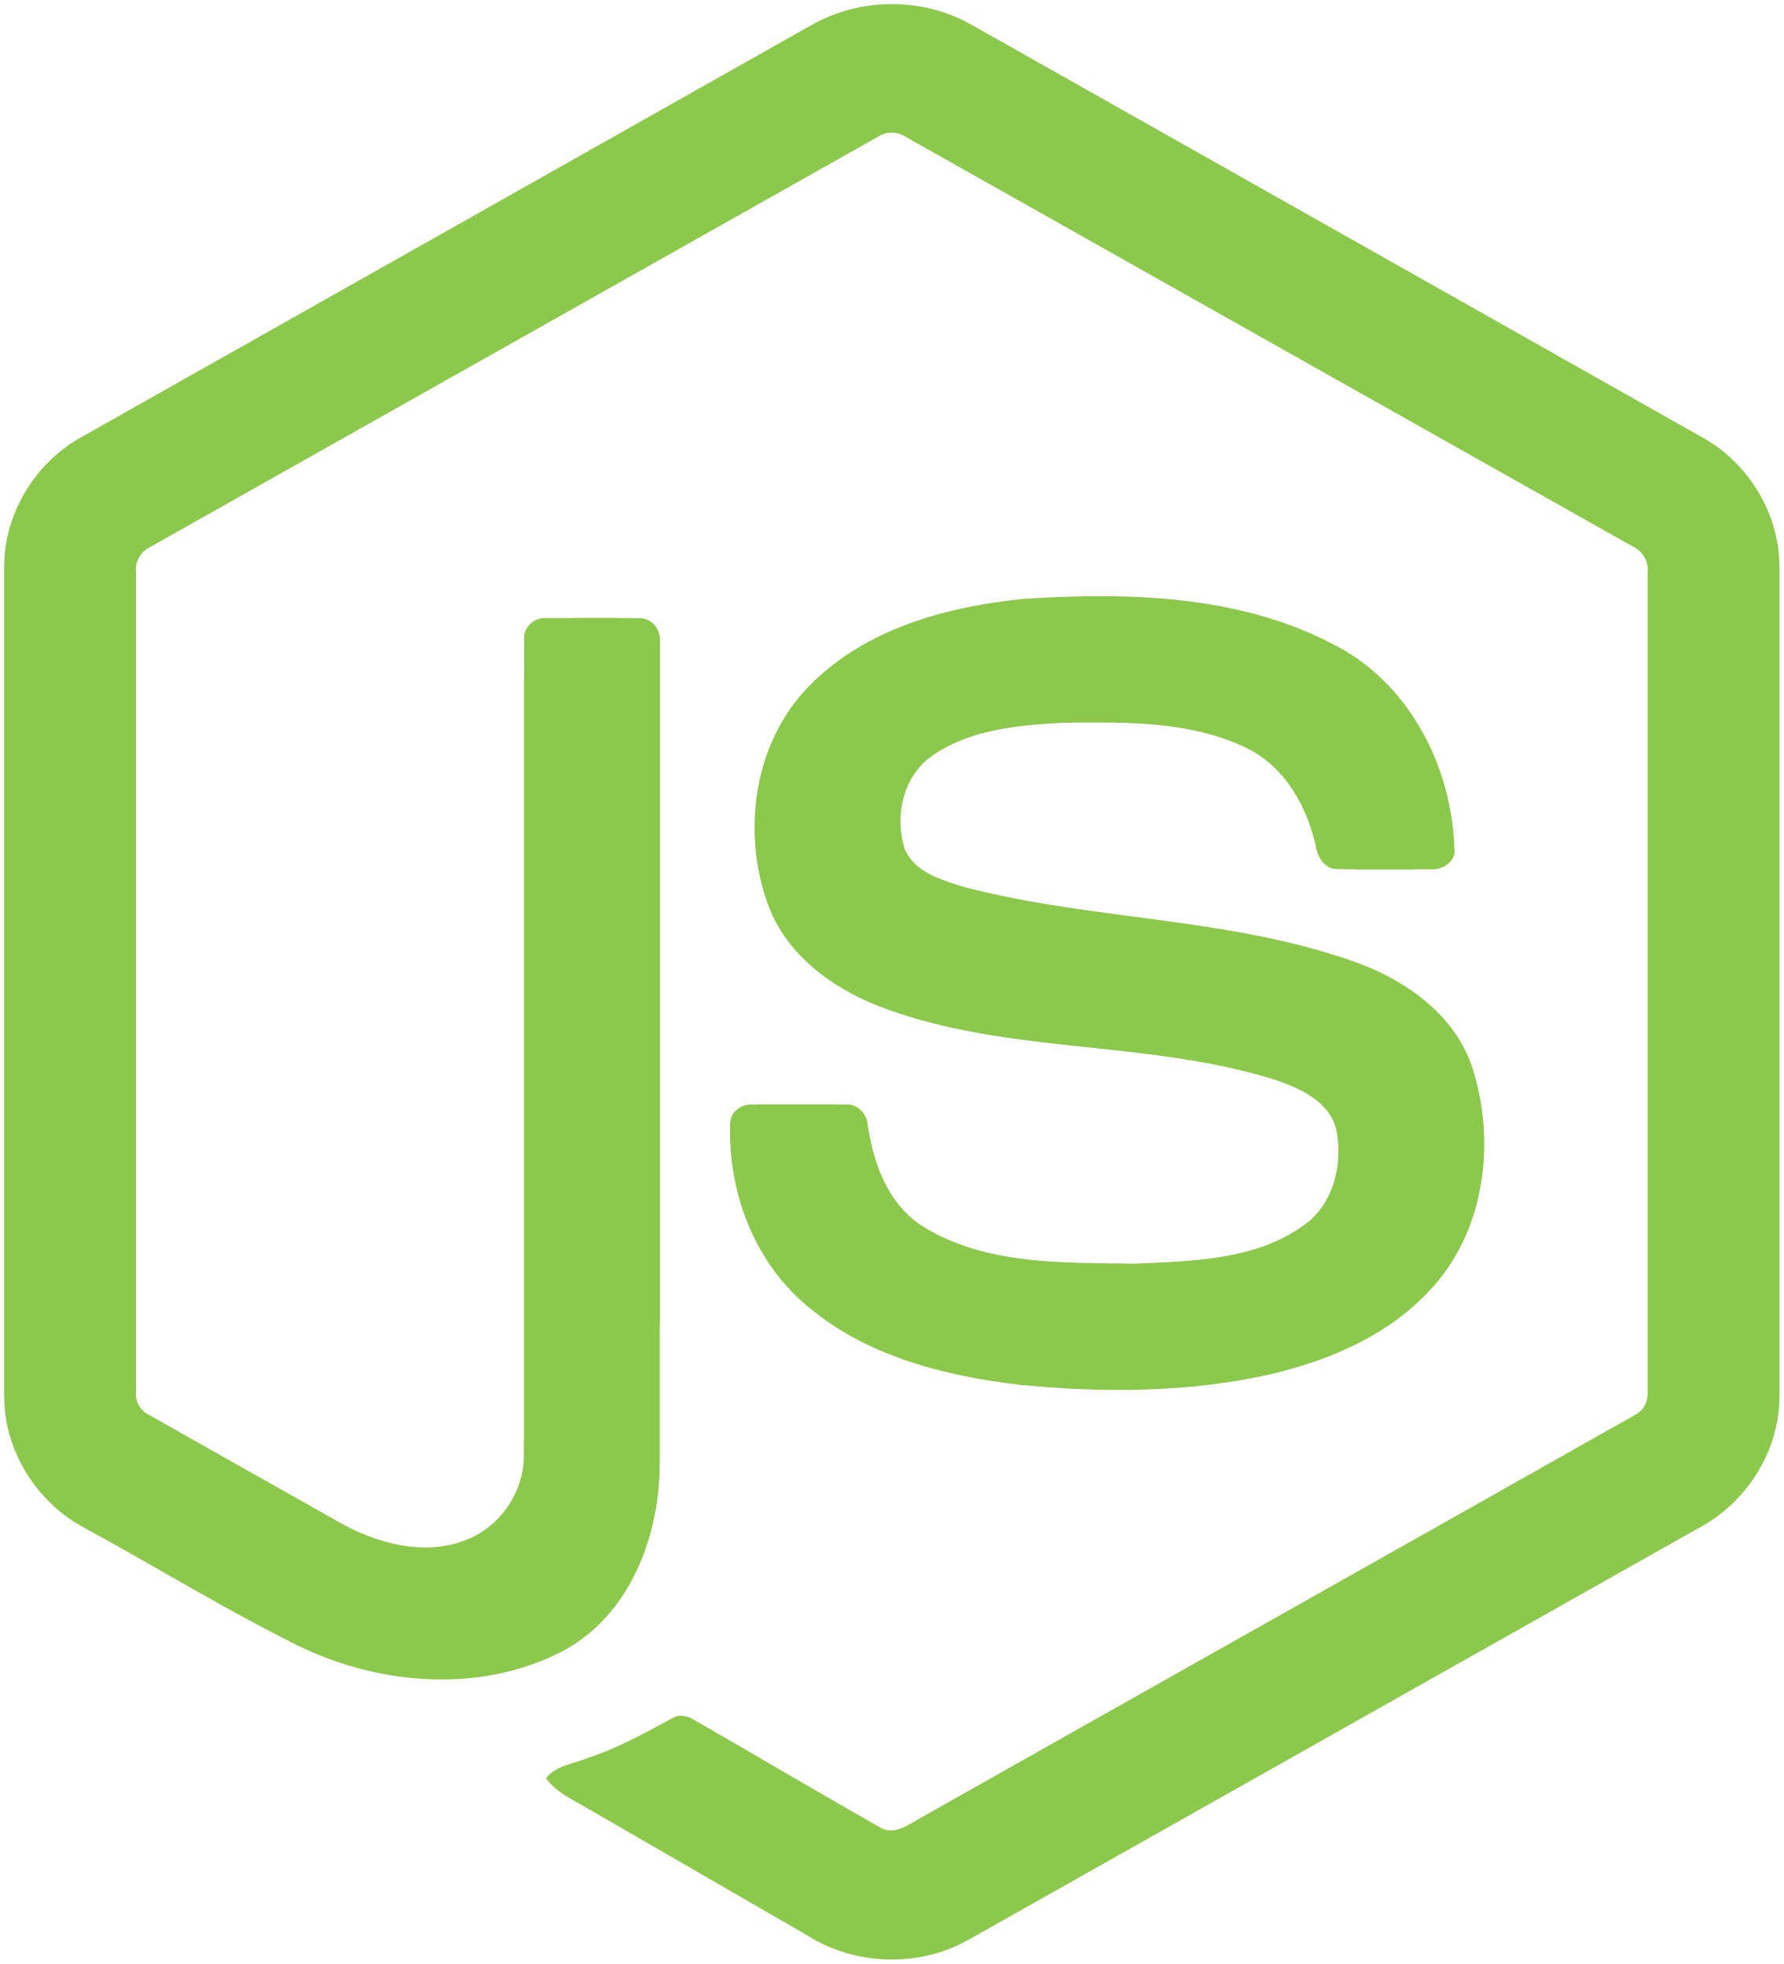


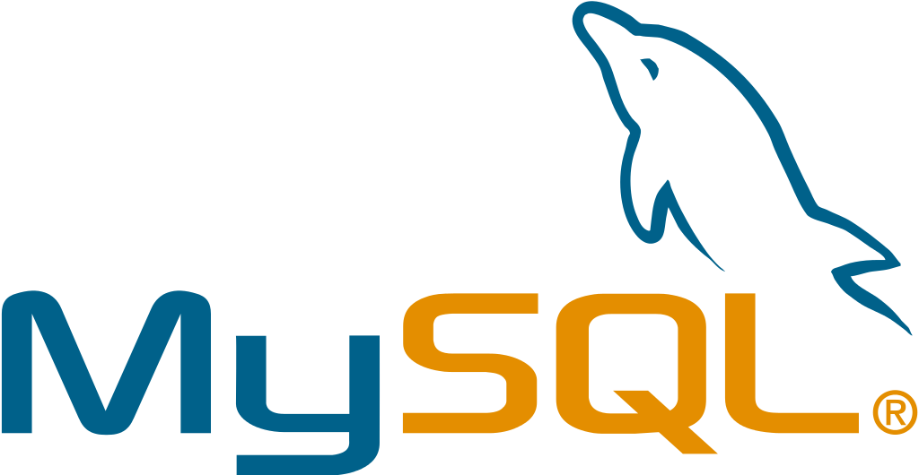







Architecture
ROUTING LAYER
SERVICE LAYER
RED HAT
ENTERPRISE LINUX
NODE
NODE
NODE
PERSISTENT
STORAGE
SCM
(GIT)
MASTER
C
C
API/AUTHENTICATION
c
CI/CD
C
C
C
DATA STORE
RHEL
RHEL
RHEL
SCHEDULER
NODE
NODE
NODE
REGISTRY
EXISTING AUTOMATION TOOLSETS
HEALTH/SCALING
C
C
C
C
C
RHEL
RHEL
RHEL
PHYSICAL
VIRTUAL
PRIVATE
PUBLIC
HYBRID

Slide 4
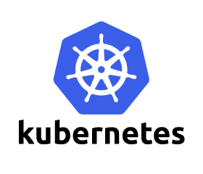



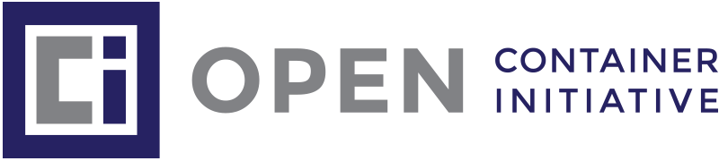

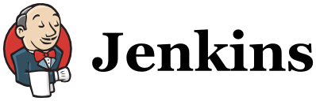
Using Kubernetes in Production
Lacks many essential components
Operating system
Container runtime (CRI-O, Containerd, Docker, etc).
Image registry
Software-defined networking
Load‐balancer and routing
Log management
Container metrics and monitoring
DNS
Load balancing
Ingress
RBAC
And it’s not just Kubernetes and Linux!
DIY means rolling your own versions of additional tools and projects as well.

Slide 5

Security
OpenShift 4.3 provides:
CRI-O engine – lightweight alternative to docker engine. Developed, tested, and released in tandem with Kubernetes major and minor releases.
Core Os – reduced attack surface as cut down bare bones os.
Access control to cluster via projects.
By default, OpenShift prevents containers from running as root.
OpenShift optionally uses FIPS 140-2 Level 1 compliant encryption modules to meet security standards for US Federal departments.

Slide 6
Monitoring & Logging
Grafana and Prometheus stack included within OpenShift – ready out of the box!
EFK Stack easily set up on OpenShift to provide indexed logs and visualisation.
Humio provides a more scalable logging option at scale.

Slide 7
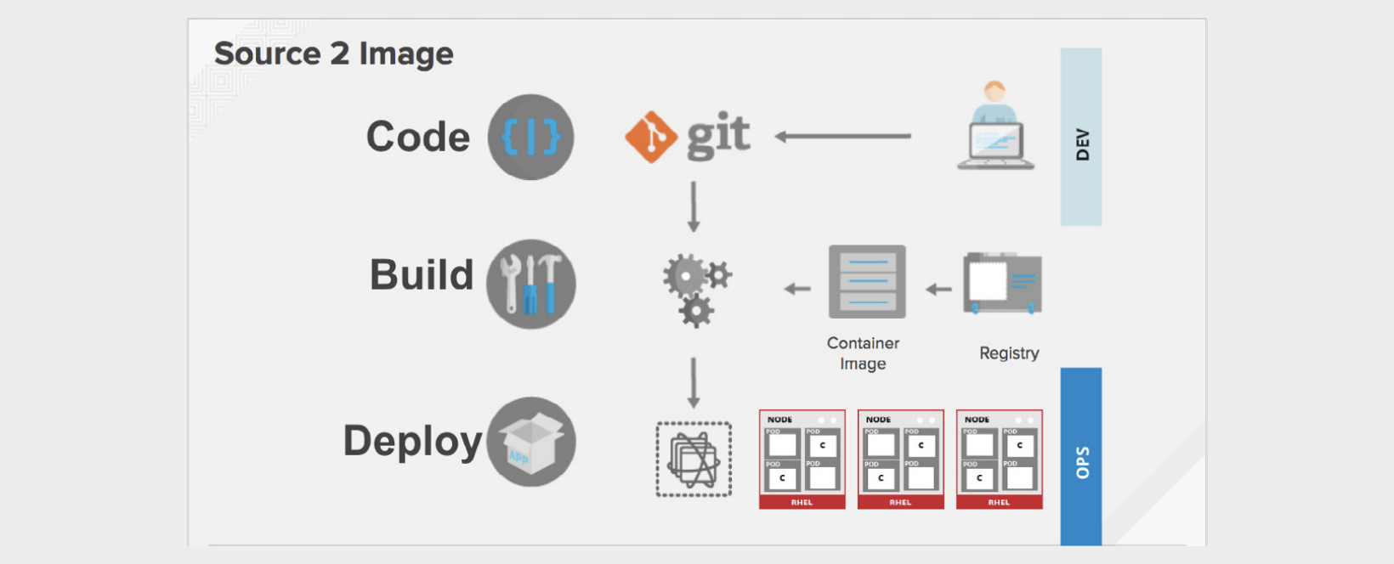
CICD
Jenkins easily deployed
OpenShift Pipelines uses Tekton under the covers.
Operators allow you to deploy a fully functioning CICD pipeline in a few lines of YAML.
S2I (Source 2 Image) –OpenShift only needs to know the URL of your git repo. OpenShift matches a base image of the desired runtime up with your source, performs a build, and then creates a new Docker image on the fly.

Slide 8
Registry
Integrates with any registry such as docker, Quay, AWS registry etc.
Images cached to internal registry to speed up deployment of images.
OpenShift provides an integrated container registry that allows applications to be scanned for vulnerability and cryptographically signed for trusted identification.

Slide 9
Openshift Vs OKD Vs Kubernetes
 |  | Openshift |  | OKD |  | Kubernetes
 |  | Container Platform |  | Project |  | Orchestration Engine
Stability | Long-term maintenance and support with backwards compatibility of bug fixes and security patches | ⬤ |  | ◯ |  | ◯
 | Security and feature backport | ⬤ |  | ◯ |  | ◯
 | Long-term support and release lifecycle management | ⬤ |  | ◯ |  | ◯
 | Config and settings tested for scale and enterprise use | ⬤ |  | ◯ |  | ◯
 | No need to understand, check, and maintain dependencies on arbitrary third-party project binaries | ⬤ |  | ◯ |  | ◯
 | Automated software updates, alerting, and management | ⬤ |  | ◯ |  | ◯
Patches/ updates | Patches provided and maintained by Red Hat | ⬤ |  | ◯ |  | ◯
 | Certified hotfixes/patches and security updates | ⬤ |  | ◯ |  | ◯
Certifications | Common Criteria certifications | ⬤ RHEL and RHEL Core OS |  | ◯ |  | ◯

Slide 10
OpenShift Vs OKD Vs Kubernetes
 |  | OpensShift |  | OKD |  | Kubernetes
 |  | Container Platform |  | Project |  | Orchestration Engine
Security | Formalized enterprise security resolution process | ⬤ |  | ◯ |  | ◯
 | Security response team identifies, tracks and resolves issues | ⬤ |  | ◯ |  | ◯
 | Containers wrapped in SELinux custom contexts via MCS | ⬤ |  | ◑ |  | ◯
 | Full SELinux container security Much stronger than the basic namespace protection | ⬤ |  | ◑ |  | ◯
 | Single Sign-On support (OAuth, SAML) | ⬤ |  | ◑ |  | ◯
Support | SLA, defect escalation, end-of-life policy management | ⬤ |  | ◯ |  | ◯
 | Support portal | ⬤ |  | ◯ |  | ◯
 | Production support | ⬤ |  | ◯ |  | ◯
 | Product developers provide support | ⬤ |  | ◯ |  | ◯
 | Ability to file request for enhancements | ⬤ |  | ◯ |  | ◯
 | Access to project leads (Clayton Coleman, Jeremy Eder, etc) | ⬤ |  | ◯ |  | ◯

Slide 11
OpenShift Vs OKD Vs Kubernetes
 |  | OpenShift |  | OKD |  | Kubernetes
 |  | Container Platform |  | Project |  | Orchestration Engine
Consulting, TAM and training certification | Expert consulting from Red Hat and certified partners | ⬤ |  | ◯ |  | ◯
 | Training content driven directly by those who wrote the code | ⬤ |  | ◯ |  | ◯
 | Training certification | ⬤ |  | ◯ |  | ◯
Quality assurance | Scalability tested/hardened | ⬤ |  | ◯ |  | ◯
 | Certification for multiple cloud providers AWS, Google GCP, Microsoft Azure | ⬤ |  | ◯ |  | ◯
Ecosystem | Third party ISV support: ex: applications running in containers and integrations | ⬤ |  | ◯ |  | ◯
 | Full stack integrations tested with Red Hat Cloud Suite* | ⬤ |  | ◯ |  | ◯
 | Full scalable SDN support via Open vSwitch (VXLAN managed by NetFlow rules) | ⬤ |  | ◯ |  | ◯
 | Dynamic storage provisioning for Persistent Volumes via EBS, Cinder, and GCE | ⬤ |  | ◑ |  | ◑

Slide 12
OpenShift Vs OKD Vs Kubernetes
 |  | OpenShift |  | OKD |  | Kubernetes
 |  | Container Platform |  | Project |  | Orchestration Engine
Developer productivity | Container development kit for developers | ⬤ |  | ◑ |  | ◯
 | Atomic Registry with tested, secured, and supported images, e.g. EAP, BRMS, BPMS, Python, etc. | ⬤ |  | ◯ |  | ◯
 | Multi-tenant experience | ⬤ |  | ◑ |  | ◯
 | Graphical experience | ⬤ |  | ◑ |  | ◯
 | Innovation Labs quick start/support | ⬤ |  | ◯ |  | ◯
 | Influence product roadmap (RFE submissions) | ⬤ |  | ◯ |  | ◯
 | Access to project leads | ⬤ |  | ◯ |  | ◯
 | CI/CD integration - support for Jenkins, Git and most other industry standards | ⬤ |  | ◑ |  | ◯
 | Production-grade container image registry (Quay)* | ⬤ |  | ◑ |  | ◯

Slide 13
OpenShift Vs OKD Vs Kubernetes
 |  | OpenShift |  | OKD |  | Kubernetes
 |  | Container Platform |  | Project |  | Orchestration Engine
Consulting, TAM and training | EFK (Elasticsearch, FluentD, Kibana - similar to ELK stack) for centralized stateless remote logging. Logging indexes manage themselves as you spin up new apps | ⬤ |  | ⬤ |  | ⬤
 | Hawkular/Heapster/Cassandra for performance metrics stack | ⬤ |  | ⬤ |  | ◯
 | Role-based access control (RBAC) | ⬤ |  | ⬤ |  | ◯
Ecosystem | Load balancers - examples: support by F5, Avinetworks, Amazon ELB, and other major load balancer providers | ⬤ |  | ⬤ |  | ◯
 | Development tools - certification to run plugins from app dev tool providers, example: Appdynamics | ⬤ |  | ⬤ |  | ◯
 | Certification for multiple cloud providers, examples: Amazon AWS, Google GCE, Microsoft Azure | ⬤ |  | ◯ |  | ◯

Slide 14
Using managed Kubernetes service locks you in with proprietary CLI’s
 |  |  | Native
 | oc adm |  | aws eks create-cluster --name POST /clusters HTTP/1.1 Host: eks.us-west-2.amazonaws.com Accept-Encoding: identity User-Agent: aws-cli/1.15.0 Python/3.6.5 Darwin/16.7.0 botocore/1.10.0 X-Amz-Date: 20180531T230747Z Authorization: AUTHPARAMS
 | oc adm |  | az aks create PUT https://management.azure.com/subscriptions/ {subscriptionId}/resourceGroups/{resourceGroupName}/providers/Microsoft.ContainerService/managedClusters/{resourceName}?api-version=2018-03-31
 | oc adm |  | gcloud container clusters create POST /v1beta1/{parent=projects/*/locations/*}/clusters

Slide 15
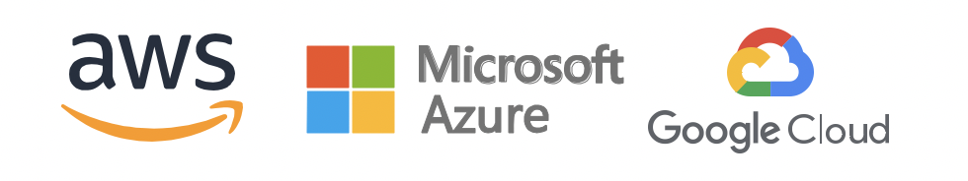
Using managed Kubernetes service locks you in with proprietary CLI’s
Developer workflow | Default: S21, Jenkins-as-a-service Optional: Third-party services |  | Each cloud has different native developer tools, could integrate third-party services
Middleware services | Default: Red Hat Middleware and Service Brokers Optional: Third-party services |  | Each cloud has different native middleware services, could integrate third-party services
Monitoring and logging | Default: Prometheus, EFK stack Optional: Third-party services |  | Each cloud has different native services, or could integrate third-party services
Networking and storage | N: CNI - multiple options supported S: Red Hat OpenShift Container Storage S: CSI - multiple options supported |  | Each service has its own network and storage configuration
Container runtime | Docker, CRI-O |  | Varies by cloud
Operating system | Enterprise-grade RHEL or Red Hat CoreOS |  | Varies by cloud
Cloud platforms supported | Any place RHEL is supported, including VMware, GCP, Azure, AWS, OpenStack and bare metal |  | Only the local cloud
Open source components | 100% open source |  | Proprietary components included

Slide 16
Installation Process on
The installation scripts provided deploy a cluster in a HA set up using terraform to provision the infrastructure in AWS.
Default set up provisions a new VPC and public and private subnets into your AWS environment.
Ansible playbooks can be used to automate the deployment of the cluster, although the value of this is limited given the process is very much automated and a one time run. Having said this if the rest of the estate is managed via ansible then this may make sense.

Slide 17
Pipelines - Build Config
A BuildConfig object is the definition of the entire build process.
Build Strategies
Docker Build – Expects a dockerfile
Source 2 Image Build - injects application source into a container image and assembling a new image.
Custom Build

Slide 18
Pipelines - Source 2 Image
Advantages
Image flexibility
Speed
Patchability – Rebuild consistently
Operational efficiency – Restrict what can be done
Operational Security – Building docker files requires root access. S2I restricts operations run as root and can run scripts as non root
User efficiency – prevents users running yum commands
Ecosystem – shared images for reuse

Slide 19
Pipelines - Tekton Demo
Tekton Run though
Tekton was originally part of the Knative project and has moved out into its own project.
Cloud Native – Runs on any cluster and has containers as their building blocks – No need for separate build machines.
Decoupled – Pipeline can deploy onto any cluster, VM’s Cloud Foundry etc.
Git Repo’s can change between runs as resources kept in separate files.
Provides K8’s style resources and makes use of Custom Resource Definition (CDR’s)
OpenShift pipelines and Jenkins X use Tekton under the covers.

Slide 20
Pipelines - Tekton Demo
Pipeline Resource
Pipeline Resource
Pipeline Resource
Pipeline Run
Pipeline
Task
Task
Task
Pipeline run defines which pipeline to run and which pipeline resources should be used.
Pipeline is made up of a set of tasks to be run
Pipeline resource – Made up of inputs such as Git Repo and image repo and outputs such as a docker image.
Tasks define a set of build steps such as compiling tests, running tests, building and deploying an image. Each step is run in its own container in that same task pod.

Slide 21
Pipelines - Tekton Demo
Installing Pipelines
Recommended approach is to install the Openshift Pipelines in OpenShift 4.3
This can be done with the following method.
Install Tekton CLI
curl -LO https://github.com/tektoncd/cli/releases/download/v0.4.0/tkn_0.4.0_Darwin_x86_64.tar.gz sudo tar xvzf tkn_0.4.0_Darwin_x86_64.tar.gz -C /usr/local/bin tkn
Install OpenShift Operator
Apply the Operator.YAML file into your cluster. This uses Operators to install the pipeline and you will then be able to apply the pipeline using the tekton CLI

Slide 22
Pipelines - Tekton Demo
Running our first pipeline and deploying into our cluster
Step 1 – Create the required files
Step 2 – Apply the files using the Tekton CLI
Step 3 – Observe the changes made.
See source code files provided for demo steps and files

Slide 23
Service Mesh Demo
Service Mesh on OpenShift is a modified version of Istio service mesh enhanced for running on OpenShift.
Service Mesh provides the following functionality
Visibility of microservices in your cluster.
Control of traffic in your cluster (Routing Rules)
Circuit breaking
Security (MTLS and strong identities of Microservces in your cluster
Uses Envoy proxy sidecar to be able to apply policies and see all traffic in the pod. Automatic or manual sidecar injection can be used.
Tools such as Jaeger provide tracing in the cluster
Kiali provides observability of the mesh
Grafana and Prometheus provide monitoring
Operators are used to install the ServiceMesh on 4.3, which take a lot of the work away.

